Slide 1
Linear Algebra
Lecture 33

Slide 2
Linear Algebra
Lecture 33

Slide 3
Eigenvalues and
Eigenvectors

Slide 4
Discrete Dynamical
Systems

Slide 5
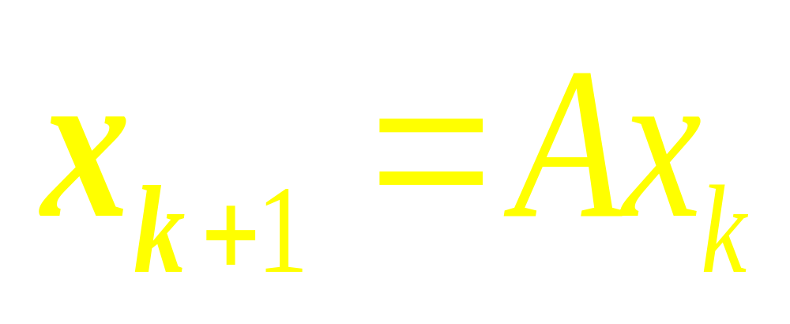

Slide 6
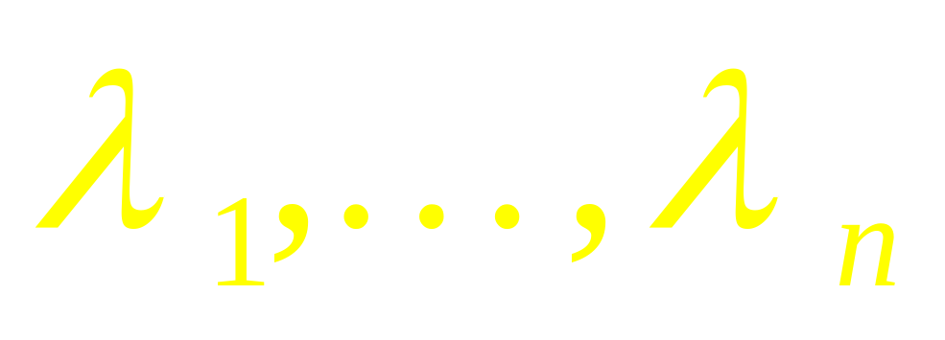
Let a matrix A is diagonalizable, with n linearly independent eigenvectors,
v₁, …, v_{n},
and corresponding eigenvalues,
…

Slide 7

For convenience, assume that the eigenvectors are arranged so that
…

Slide 8
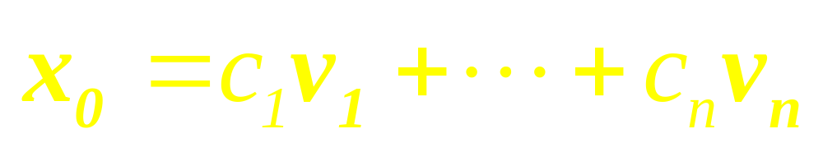
Since { v₁, …, v_{n} } is a basis for R^{n}, any initial vector x₀ can be written uniquely as
…

Slide 9
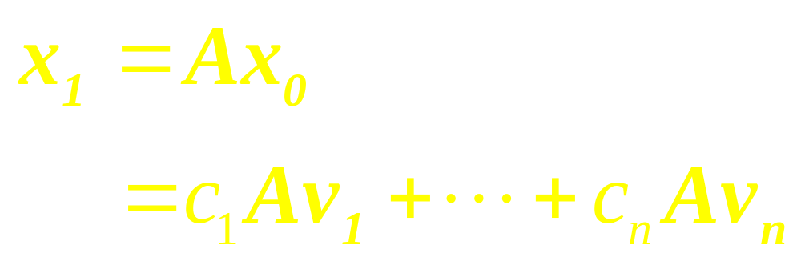
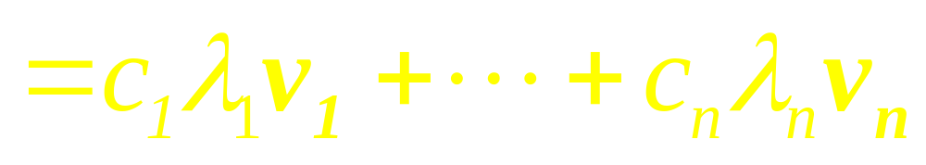
Since the v_{i} are eigenvectors,

Slide 10
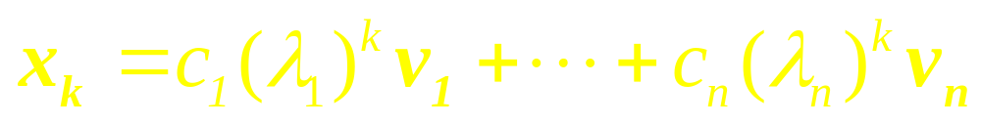

In general,

Slide 11
Example 1

Slide 12
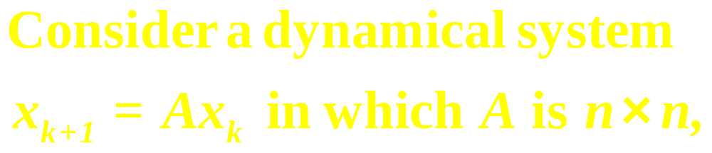
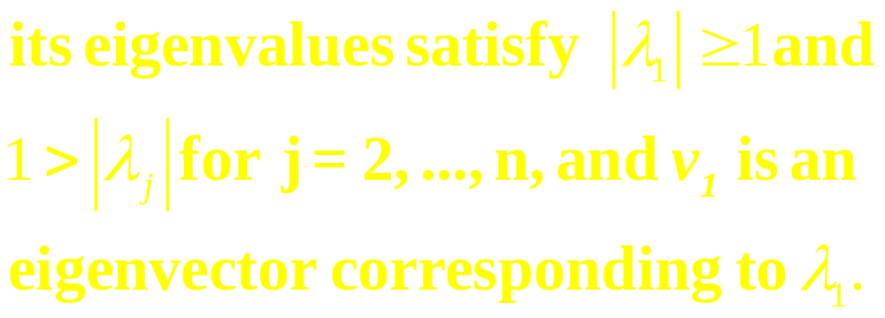
Observe
…

Slide 13
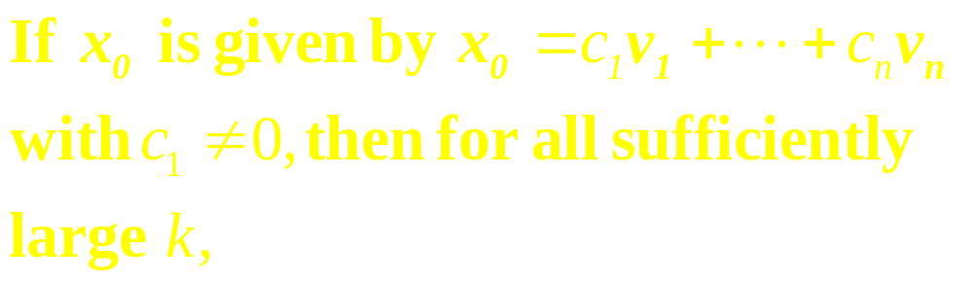
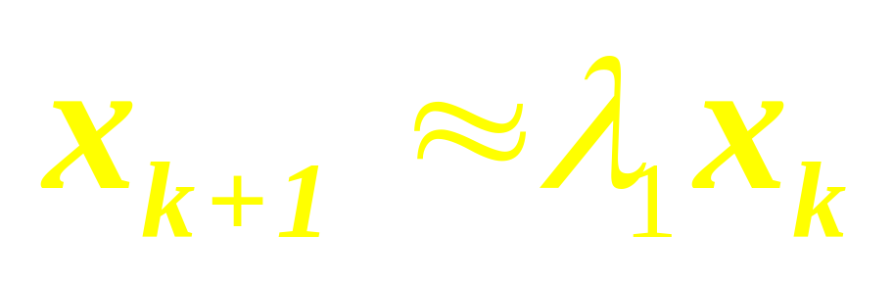
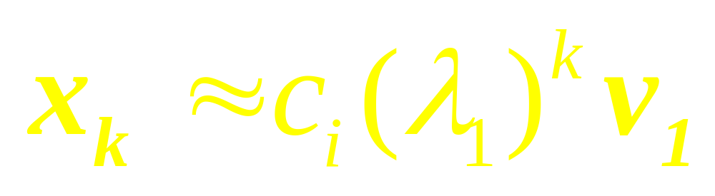
continued

Slide 14
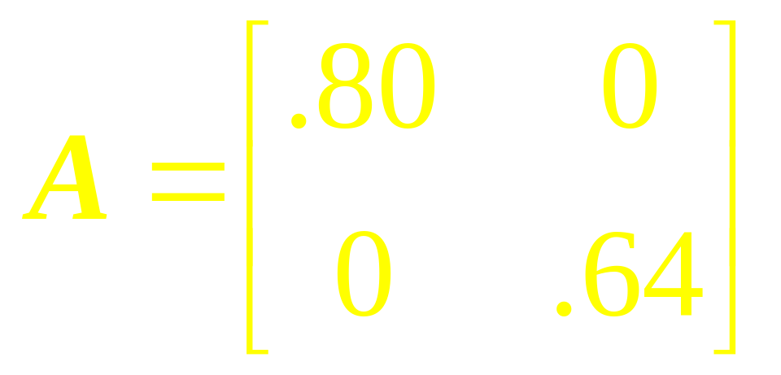
Example 2
Plot several trajectories of the dynamical system
x_{k+1} = Ax_{k}, when

Slide 15
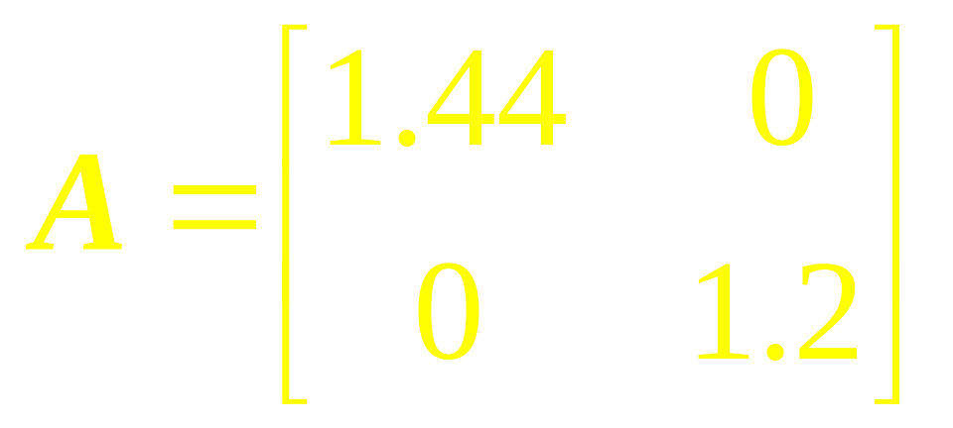
Example 3
Plot several typical solution of the equation
x_{k+1} = Ax_{k}, when

Slide 16
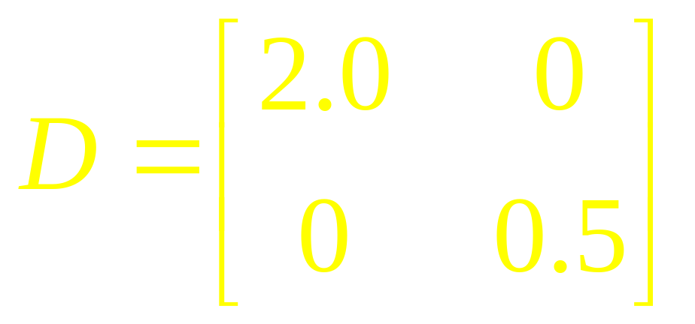
Example 4
Plot several typical solution of the equation
y_{k+1} = Dy_{k}, where
…

Slide 17
Show that a solution {y_{k}} is unbounded if its initial point is not on the x₂-axis.

Slide 18
Change of
Variable

Slide 19
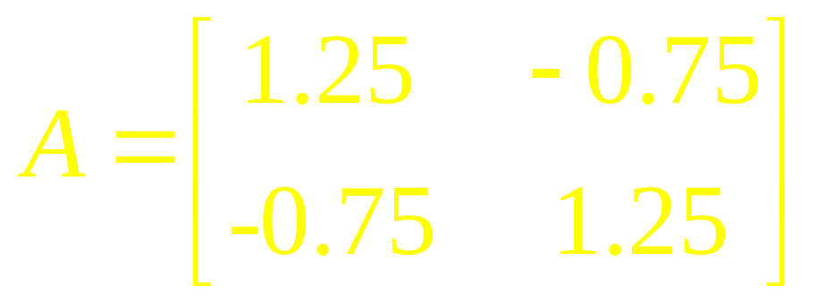
Example 5
Show that the origin is a saddle point for solutions of x_{k+1} = Ax_{k}, where
…

Slide 20
Find the directions of greatest attraction and greatest repulsion.

Slide 21
Note
If A has two complex eigenvalues whose absolute value is greater than 1, then 0 is a repellor and iterates of x₀ will spiral outward around the origin.
…

Slide 22
continued
If the absolute values of the complex eigenvalues are less than 1, the origin is an attractor and the iterates of x₀ spiral inward toward the origin.

Slide 23
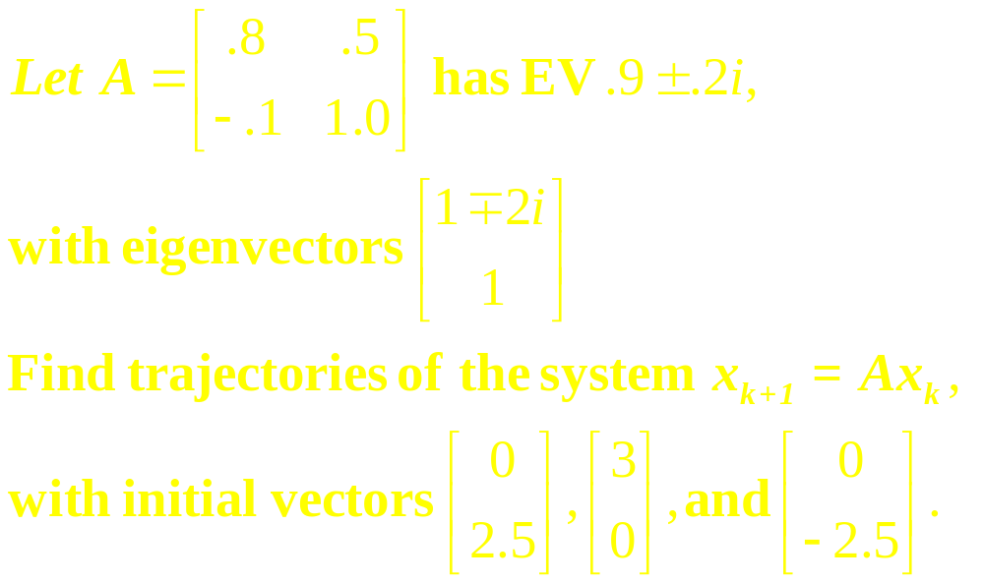
Example 6

Slide 24
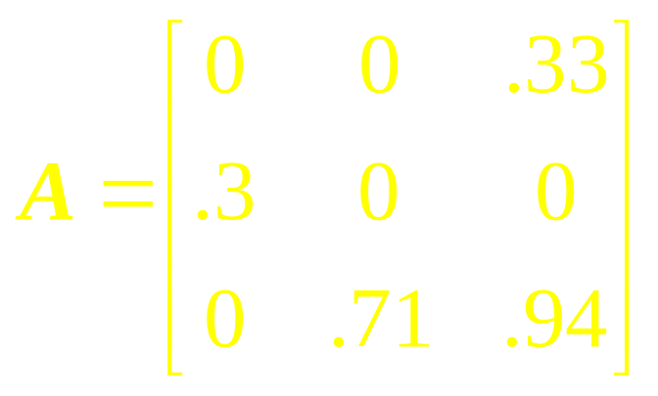
Example 7
Suppose the search survival rate of young bird is 50%, and the stage-matrix A is
…

Slide 25
continued
What does the stage-matrix model predict about this bird?

Slide 26
Linear Algebra
Lecture 33

